Slide 1


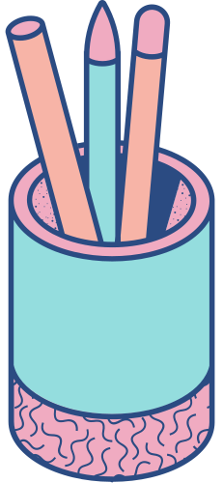


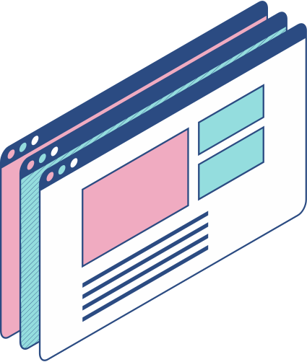
A QUICK INFORMATION GUIDE
EduConnect
Raditya Ihsan Dito - 2106733912
Michael Winston Tjahaja - 2106731270

Slide 2
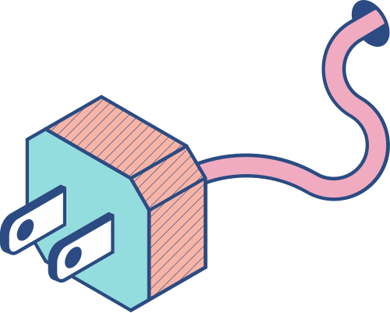
What is EduConnect
Edu-Connect is a platform where education is redefined using a website to connect both teachers and students alike, creating a platform where interactions between the two are simplified using a database where the teachers are able to upload tasks to their dedicated courses and grade those tasks, and students are able to take courses, read the materials of all the courses, whilst also being able to submit their finished work.

Slide 3
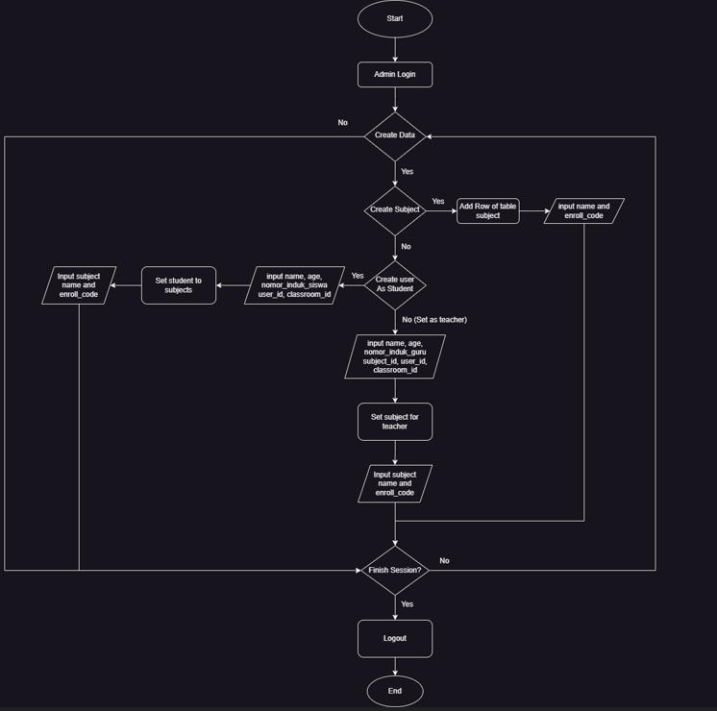
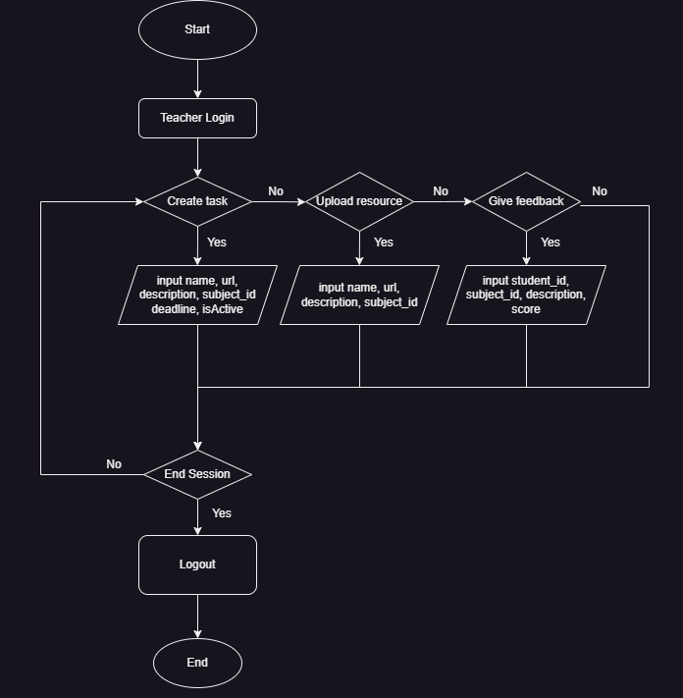
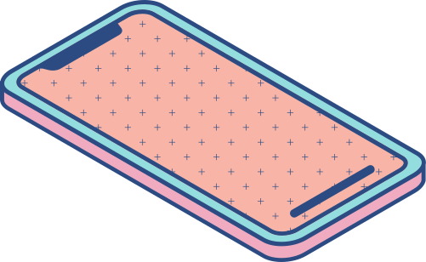
Admin Flowchart
Teacher Flowchart

Slide 4
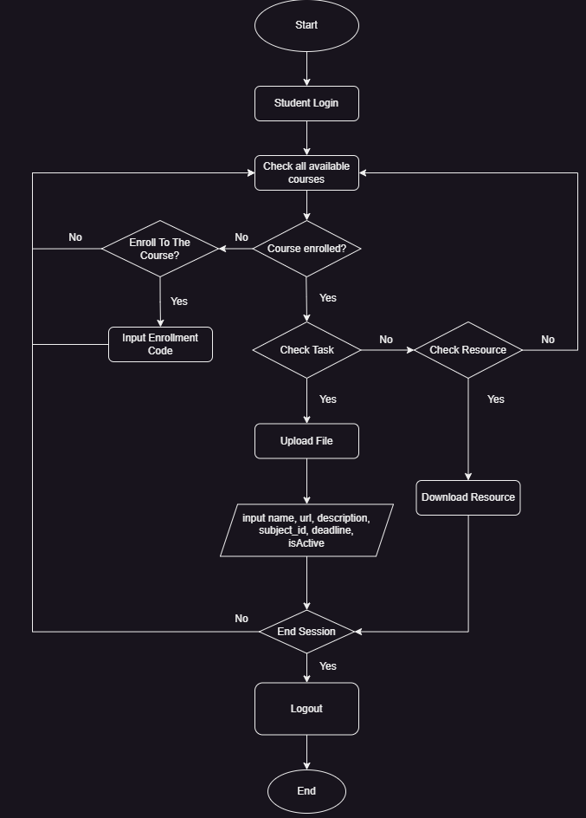
Student Flowchart

Slide 5

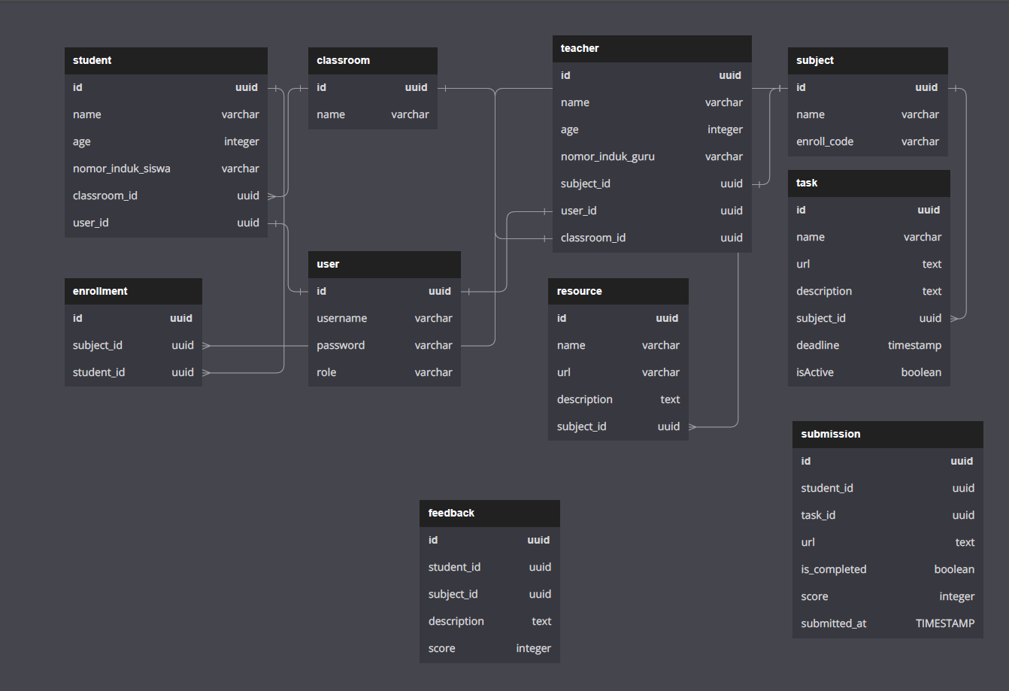
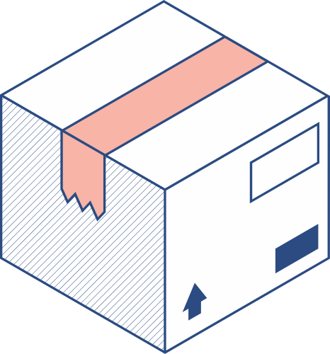
UML

Slide 6
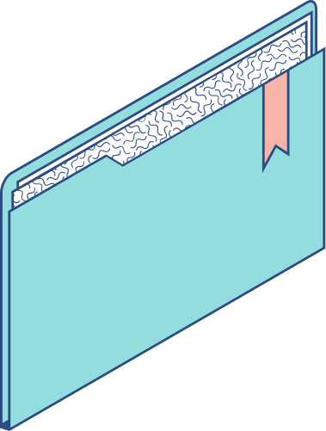
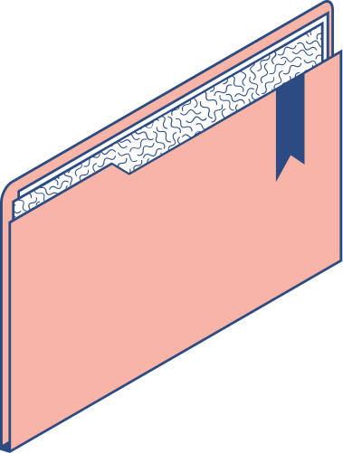
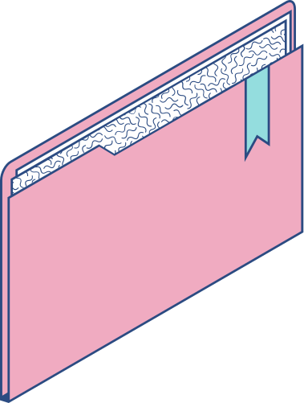
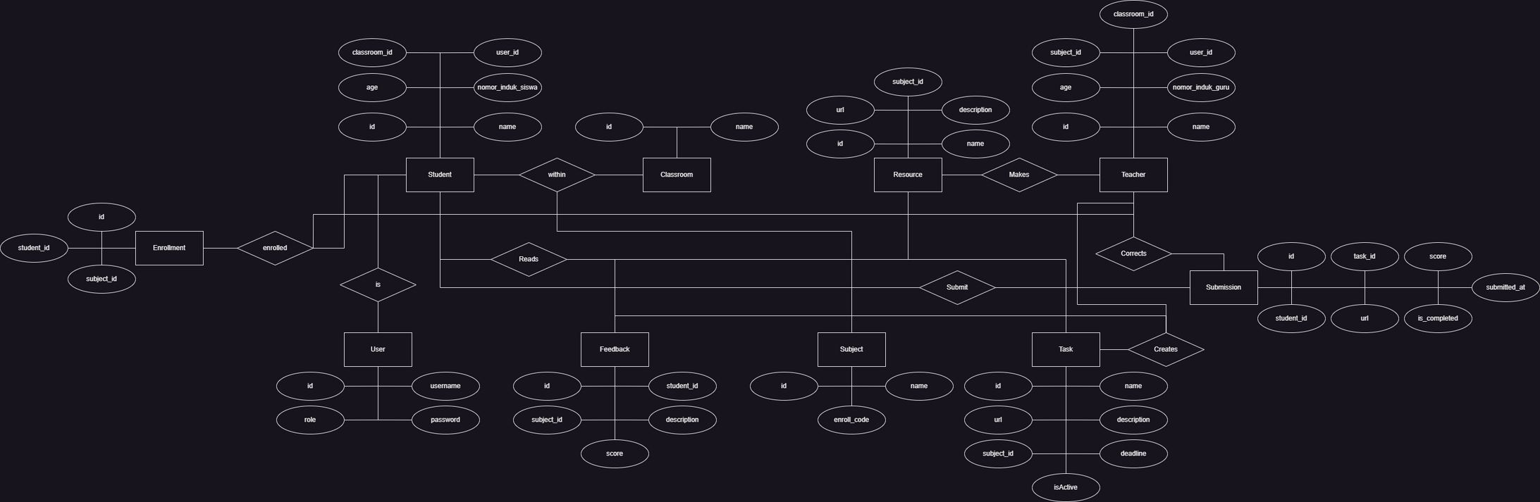
ERD

Slide 7
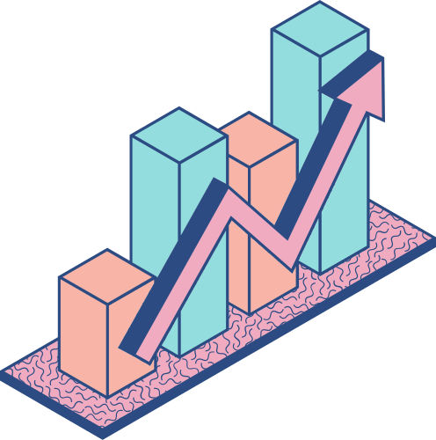
Website Demo

Slide 8
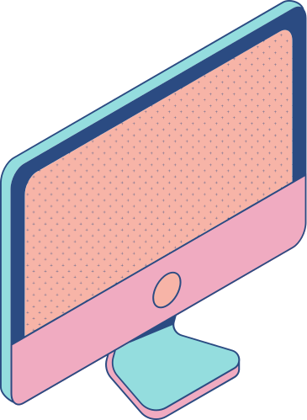
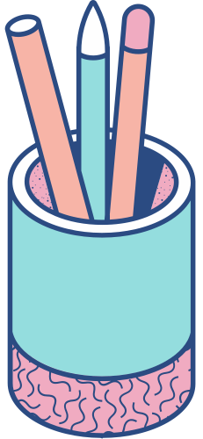

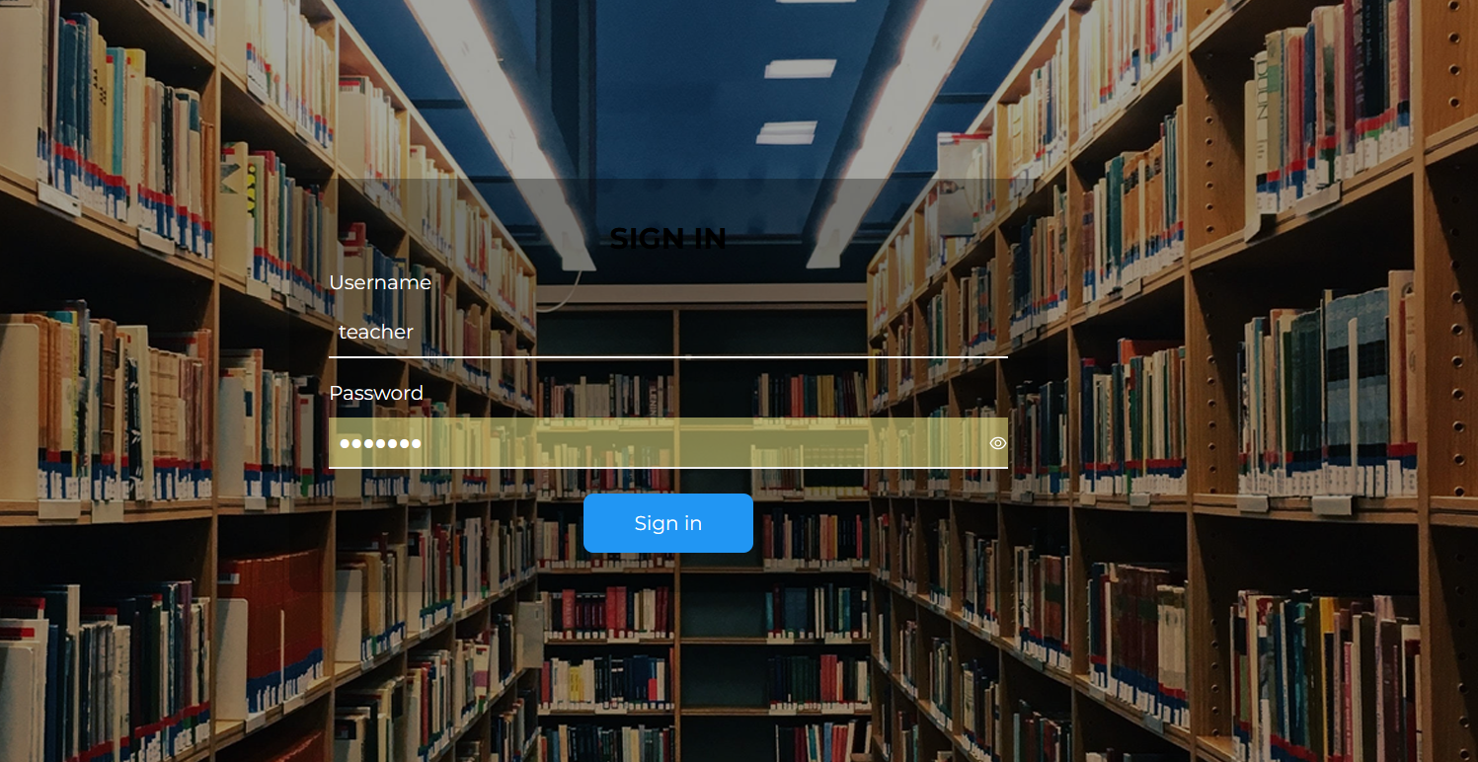
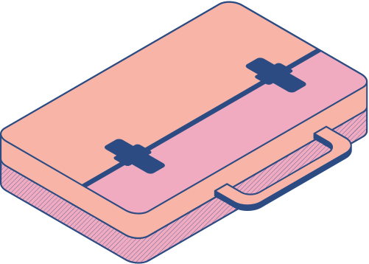
Login Page

Slide 9
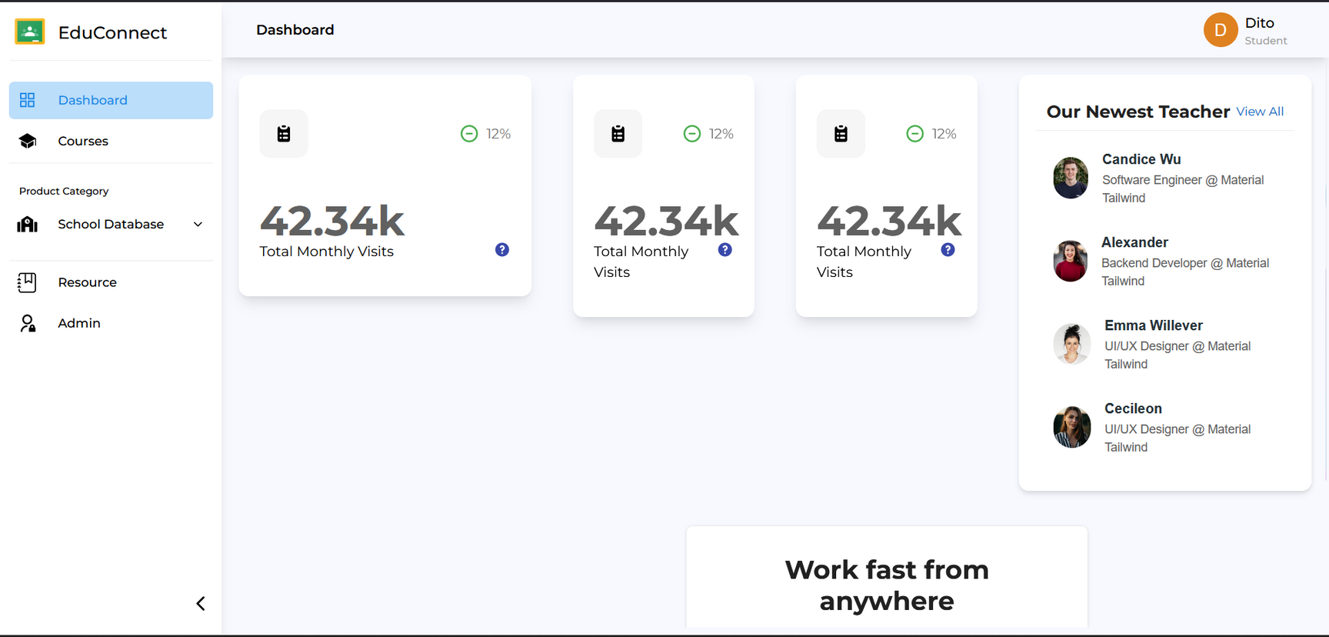
Dashboard

Slide 10
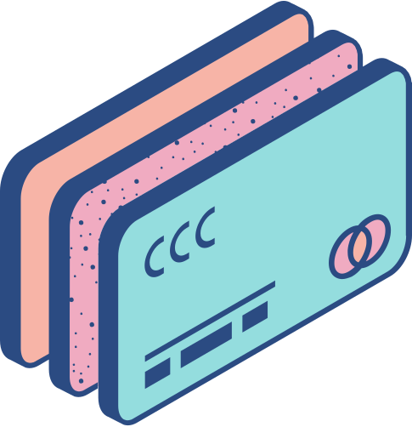
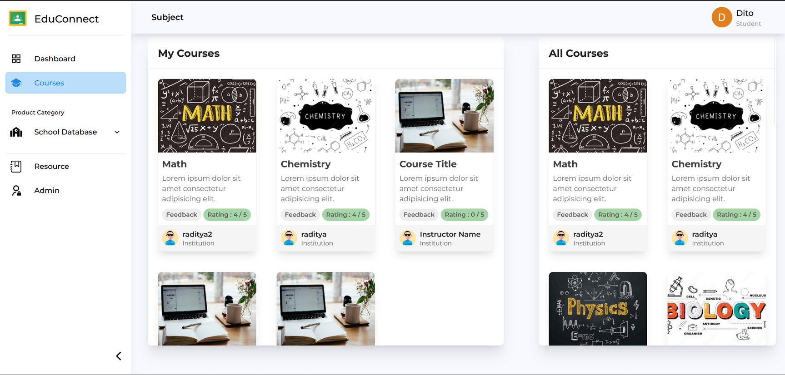
Courses Page

Slide 11
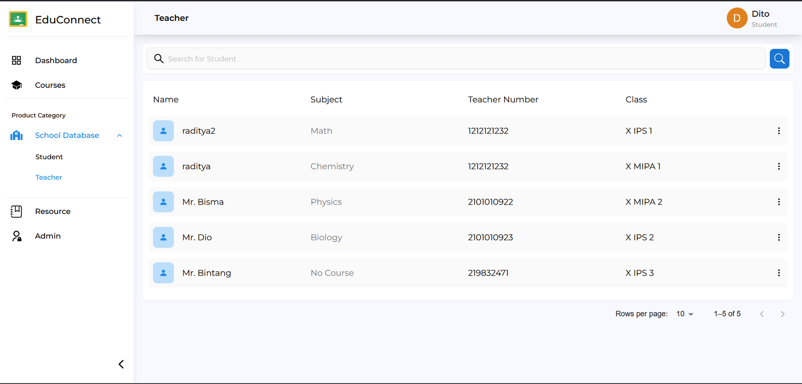
Teachers Page

Slide 12
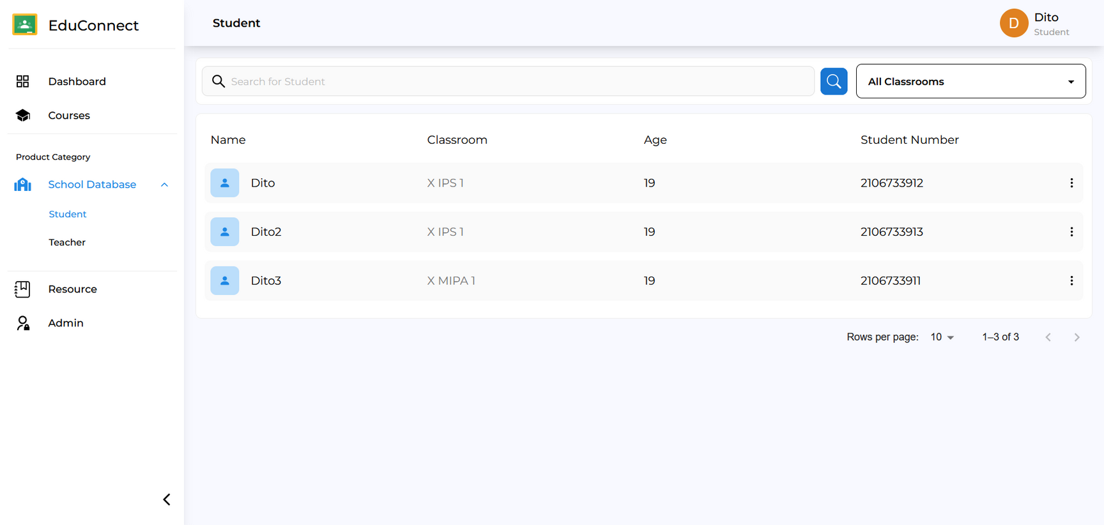
Student Page

Slide 13
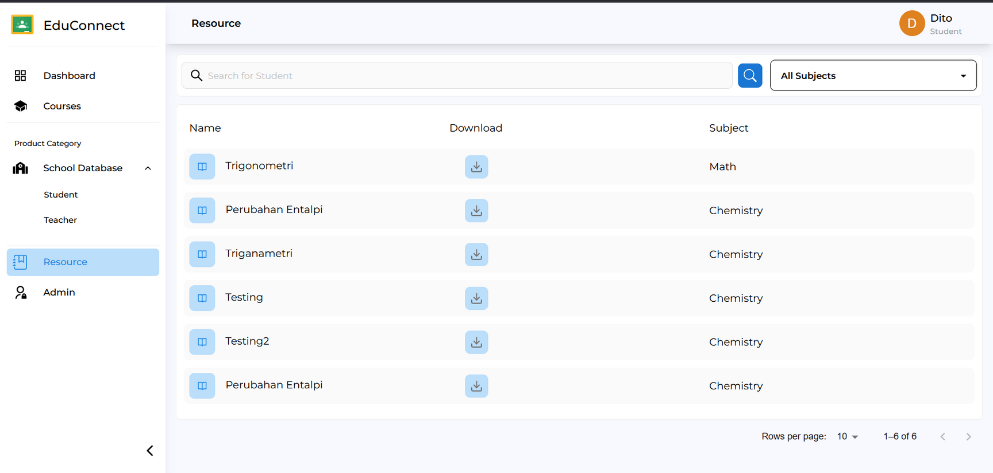
Resource Page

Slide 14
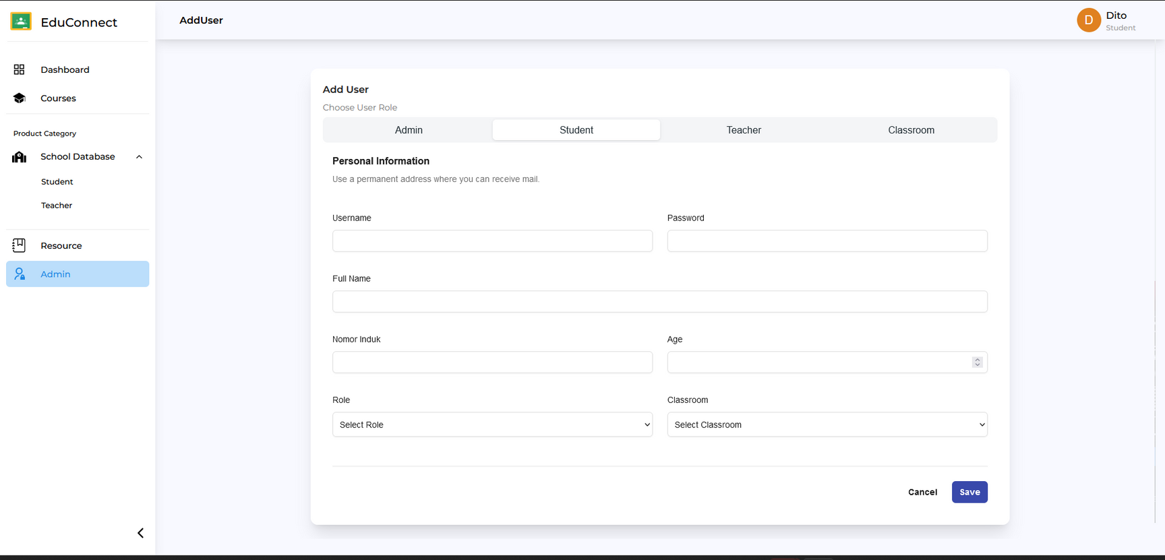
Admin Page

Slide 15
Teachers Page

Slide 16
Student Page

Slide 17
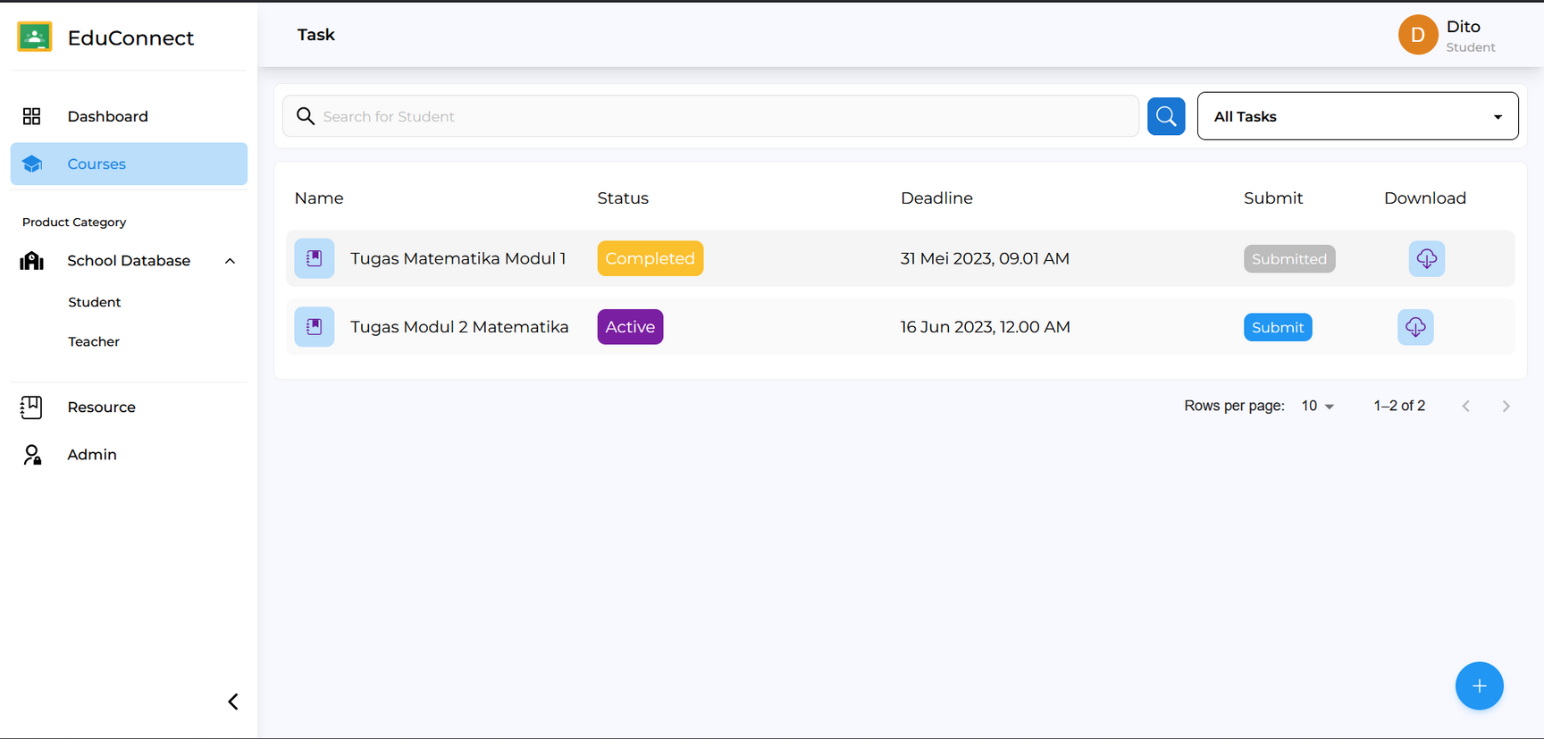
Task Page

Slide 18
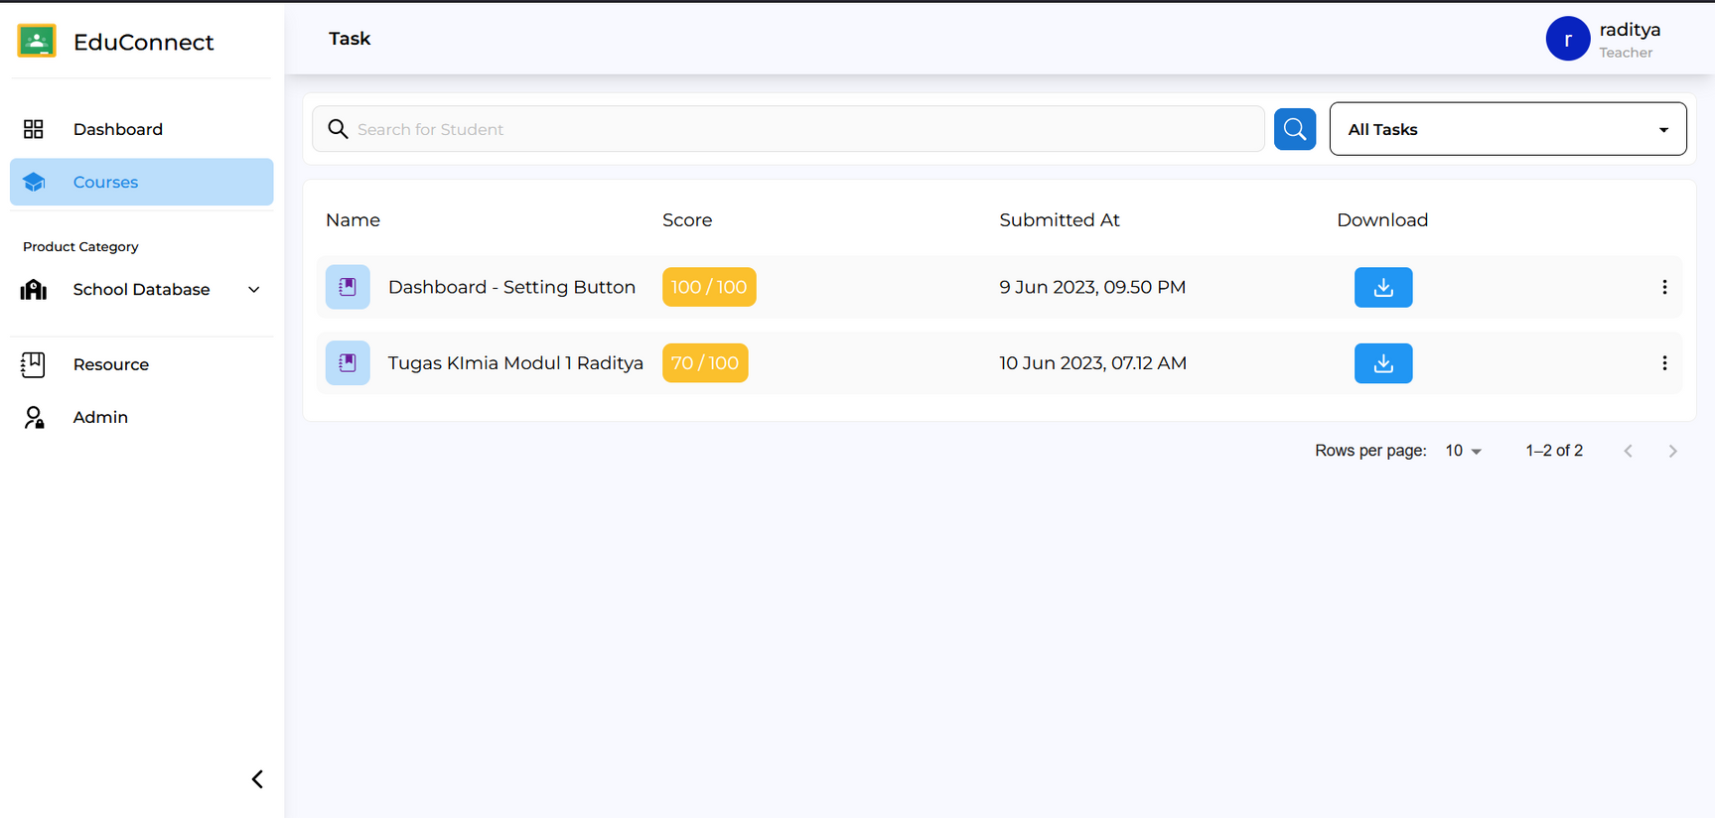
Submission Page

Slide 19
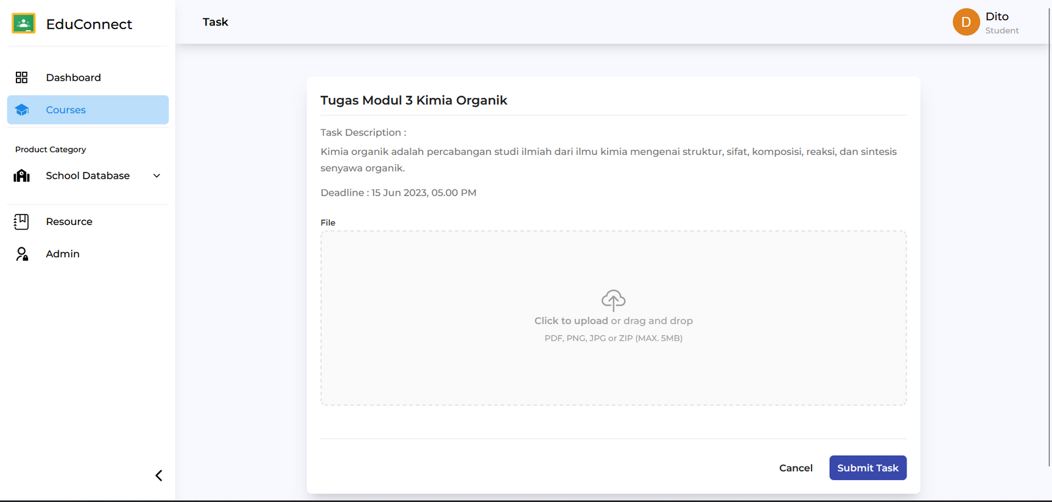
Task Submit

Slide 20
Allows for a more personalized learning experience
Students have more freedom to choose the methods and tools that help them learn best.
Improves students' communication skills
Students have access to different channels where they can communicate and collaborate with teachers and fellow students.
Helps students prepare for the future
Students become equipped to face a highly technological future and will be able to easily adapt.
Benefits
to Students
HOW OUR WEBSITE HELPS STUDENTS LEARN

Slide 21
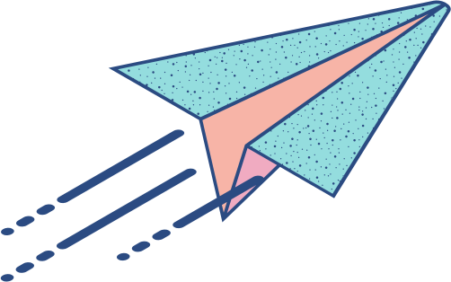
Do you have any questions?
QnA :D

